Slide 1
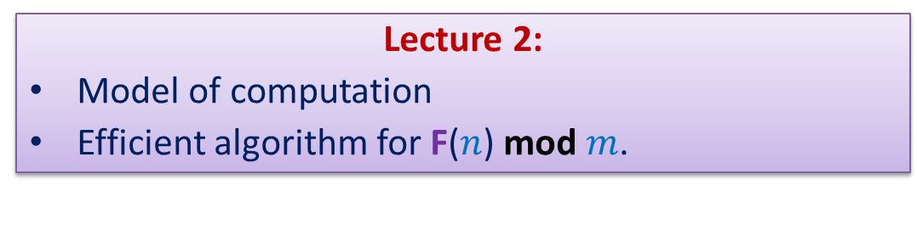
Data Structures and Algorithms (ESO207)
Lecture 2:
Model of computation
Efficient algorithm for F($n$) mod $m$.

Slide 2
Recap of the 1st Lecture

Slide 3
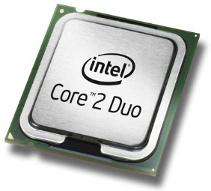
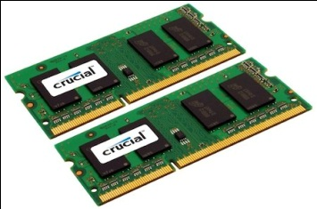
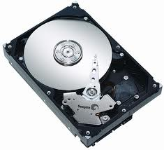
Current-state-of-the-art computer
A processor (CPU)
speed = few GHz
(a few nanoseconds to execute an instruction)
Internal memory (RAM)
size = a few GB (Stores few million bytes/words)
speed = a few GHz(a few nanoseconds to read a byte/word)
External Memory (Hard Disk Drive)
size = a few tera bytes
speed : seek time = miliseconds
transfer rate= a billion bytes per second

Slide 4
Motivation
for Efficient algorithms
Subset sum problem
Sorting
for Efficient Data Structures
Telephone Directory
Range Minima

Slide 5
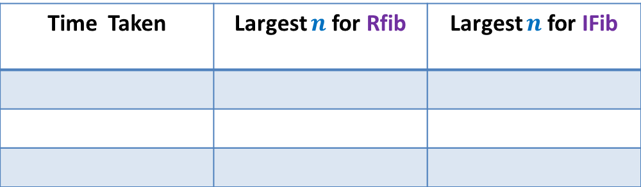




Homework 1
Write a C program for the following problem:
Input: a number $n$
$n$ : long long int (64 bit integer).
Output: F($n$) mod $2023$
Time Taken | Largest $n$for Rfib | Largest $n$for IFib
1 minute
48
$$4.5 ×{10}^{9}$$
Processor: 2.7 GHz
10 minutes
53
$$4.5 ×{10}^{10}$$
60 minutes
58
$$2.6 ×{10}^{11}$$
Here are the values obtained by executing the program
on a typical computer.

Slide 6
Inferences from the Homework
Inference for RFib algorithm
Too slow ☹
Inference for Ifib algorithm :
Faster than Rfib
But not a solution for the problem ☹
Efficiency of an algorithm
Time taken to solve a problem may vary
does matter
depending upon the algorithm used
How to analyse the efficiency of an algorithm ?

Slide 7
Current-state-of-the-art Computer
A model of computation
Simple
Close to real world computer

Slide 8
word RAM : a model of computation

Slide 9
word RAM : a model of computation
Data
Processor
Program
RAM

Slide 10
How is an instruction executed?
Decoding instruction
fetching the operands
performing arithmetic/logical operation
storing the result back
into RAM
➔ Each instruction takes a few cycles (clock ticks) to get executed.
Processor
RAM

Slide 11
word RAM model of computation: Characteristics
Word (can be a number, name) is the basic storage unit of RAM. Word is a collection of few bytes.
Each word is stored in binary format.
RAM can be viewed as a huge array of words.
Any arbitrary location of RAM can be accessed in the same time
irrespective of the location.
Data as well as Program reside fully in RAM.
Each arithmetic or logical operation (+,-,*,/,or, xor,…)
involving a constant number of words
takes a constant number of cycles (steps) by the CPU.

Slide 12
Efficiency of an algorithm
Question: How to measure time taken by an algorithm ?
Number of instructions taken in word RAM model.
What about the influence of so many other parameters ?
Variation in the time of various instructions
Architecture : 32 versus 64
We shall judge the influence, if any, of these parameters through experiments.
Code optimization due to Compiler
Multitasking due to Operating system
Who knows, these factors might have
little or negligible impact on most of algorithms. ☺

Slide 13
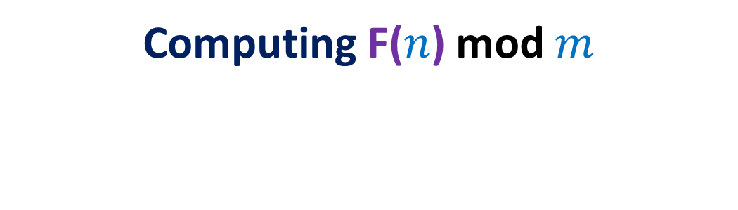
Homework 1 from Lecture 1
Computing F($n$) mod $m$

Slide 14
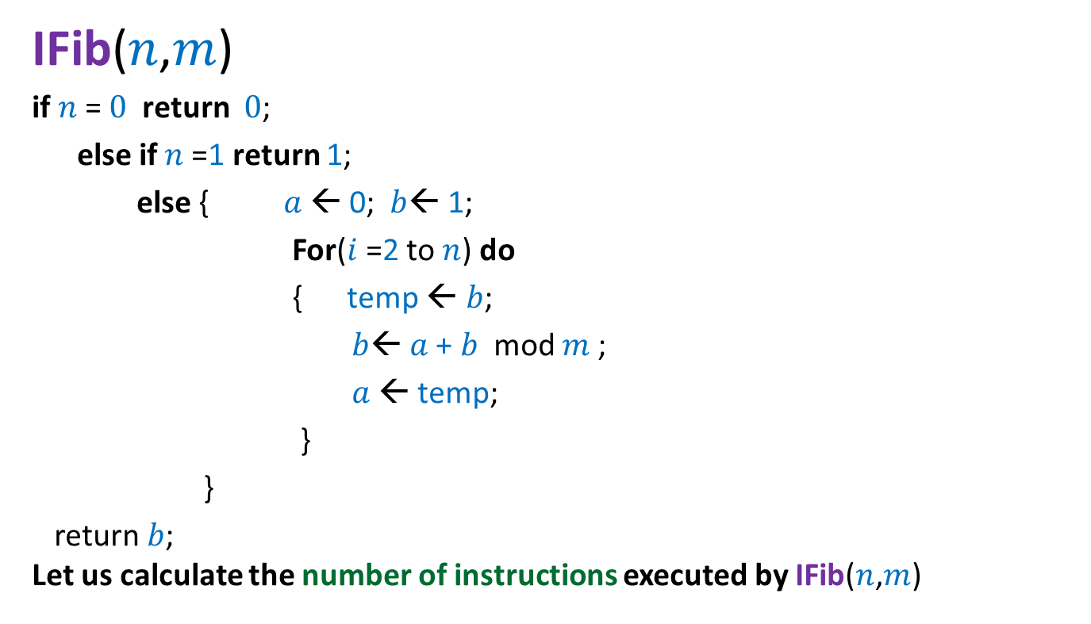


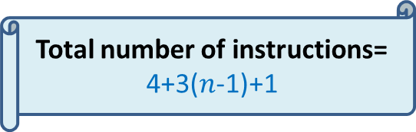
Iterative Algorithm for F($n$) mod $m$
Total number of instructions= 4+3($n$-1)+1
IFib($n$,$m$)
if $n$= $0$ return $0$;
else if $n$=1 return 1;
else { $a$ ← 0; $b$← 1;
For($i$=2 to $n$) do
{ temp ← $b$;
$b$← $a$+ $b$ mod $m$;
$a$← temp;
}
}
return $b$;
Let us calculate the number of instructions executed by IFib($n$,$m$)
$≈$ 3$n$
4 instructions
n-1 iterations
3 instructions per iteration
the final instruction

Slide 15
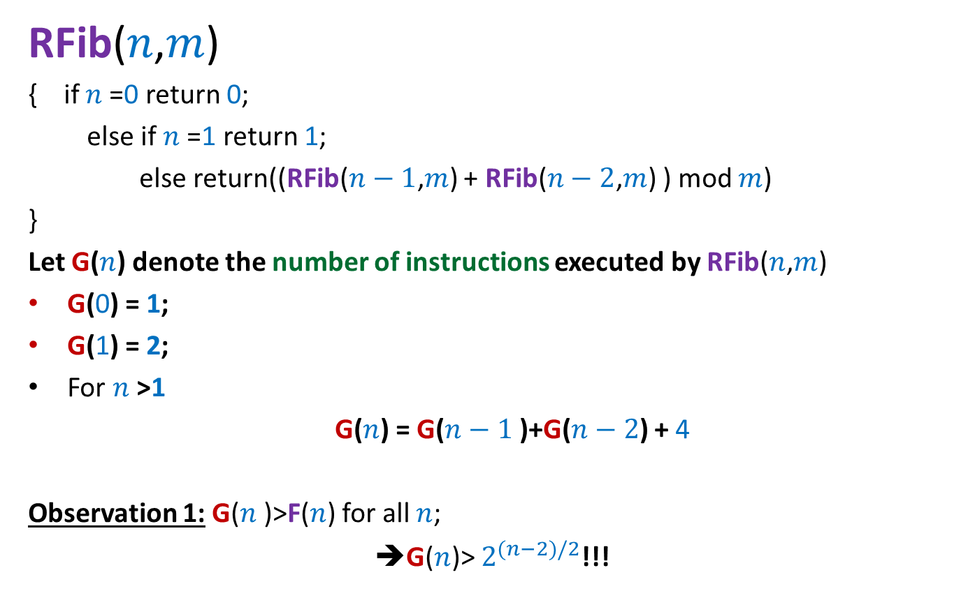
Recursive algorithm for F(n) mod m
RFib($n$,$m$)
{ if $n$=0 return 0;
else if $n$=1 return 1;
else return((RFib($n−1$,$m$) + RFib($n−2$,$m$) ) mod $m$)
}
Let G($n$) denote the number of instructions executed by RFib($n$,$m$)
G(0) = 1;
G(1) = 2;
For $n$>1
G($n$) = G($n−1$)+G($n−2$) + 4
Observation 1: G($n$)>F($n$) for all $n$;
➔G($n$)> $2^{(n−2)/2}$!!!

Slide 16
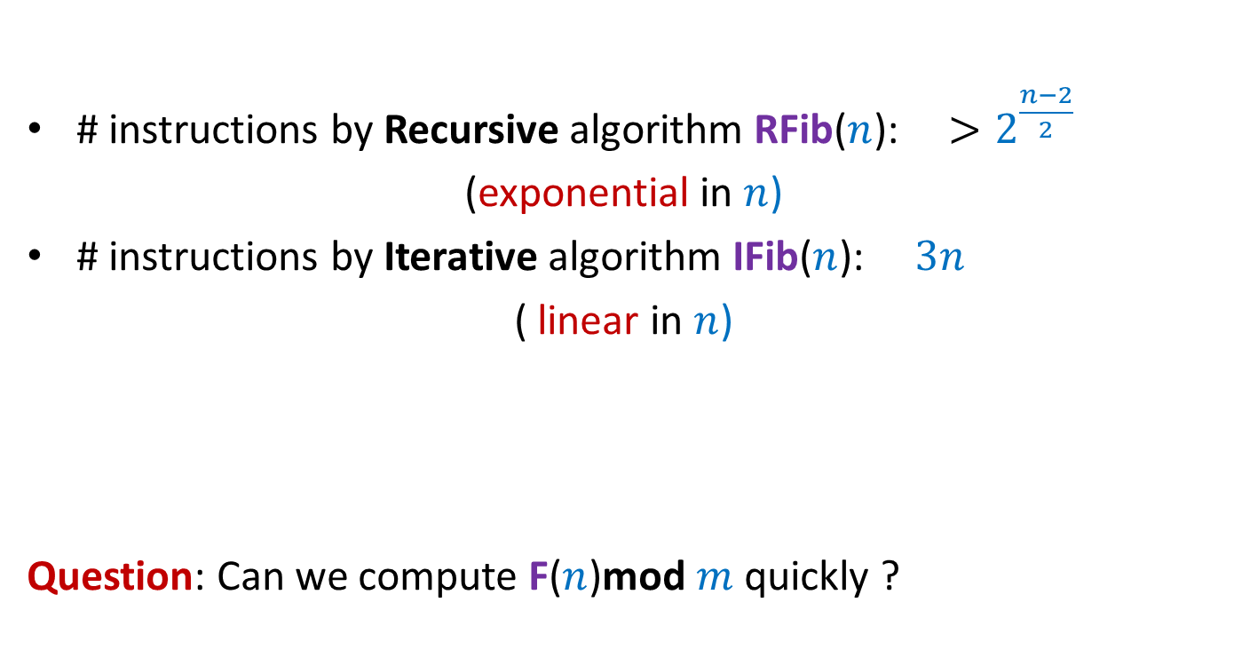


Algorithms for F($n$)mod $m$
# instructions by Recursive algorithm RFib($n$): $>2^{\frac{n−2}{2}}$
(exponential in $n$)
# instructions by Iterative algorithm IFib($n$): $3n$
( linear in $n$)
Question: Can we compute F($n$)mod $m$quickly ?
None of them works for entire range of long long int $n$ and int $m$

Slide 17

How to compute F($n$)mod $m$quickly ?
… need some better insight …

Slide 18
A warm-up example
How good are your programming skills ?

Slide 19
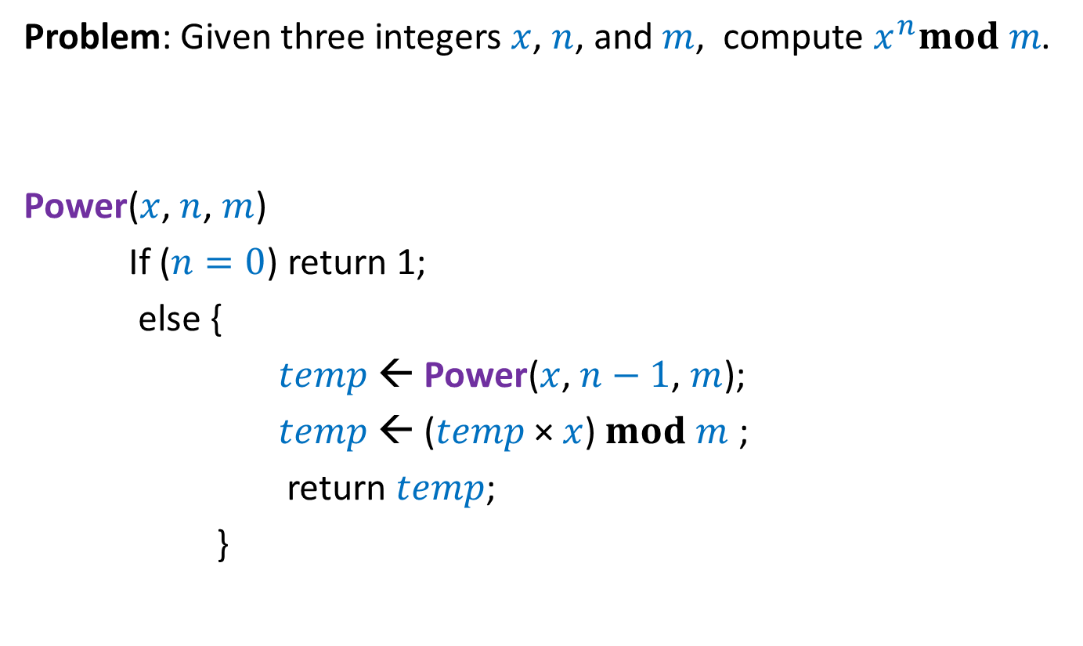

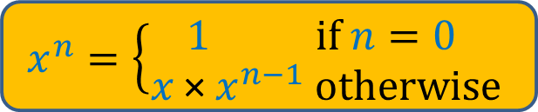
Compute $x^{n}mod m$
Problem: Given three integers $x$, $n$, and $m$, compute $x^{n}mod m$.
Power($x$, $n$, $m$)
If ($n=0$) return 1;
else {
$temp$← Power($x$, $n−1$, $m$);
$temp$← ($temp$× $x$) $mod m$ ;
return $temp$;
}
$$x^{n}=\left\{\begin{aligned}1 if n=0 \\ x \text{×} x^{n−1} otherwise\end{aligned}\right.$$
4 instructions
excluding the
Recursive call

Slide 20

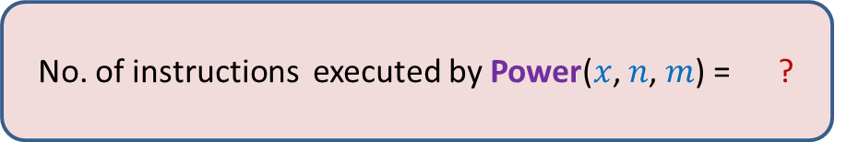
Compute $x^{n}mod m$
Problem: Given three integers $x$, $n$, and $m$, compute $x^{n}mod m$.
Power($x$, $n$, $m$)
Power($x$, $n−1$, $m$);
Power($x$, $n−2$, $m$);
Power($x$, $0$, $m$)
$$x^{n}=\left\{\begin{aligned}1 if n=0 \\ x \text{×} x^{n−1} otherwise\end{aligned}\right.$$
No. of instructions executed by Power($x$, $n$, $m$) = ?
$$4n$$

Slide 21
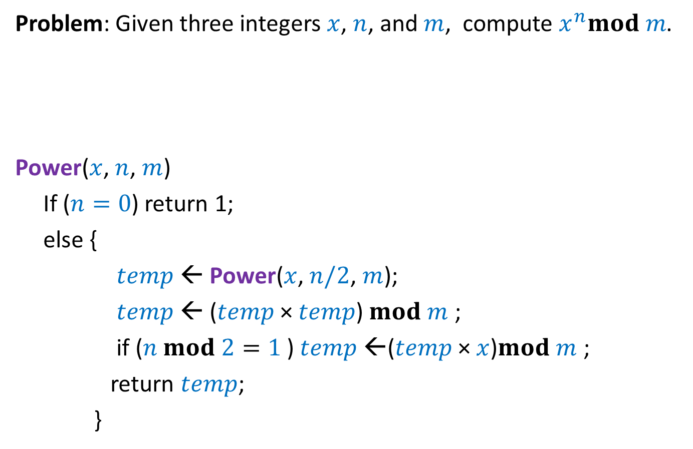
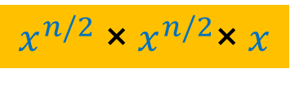
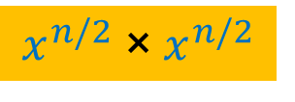
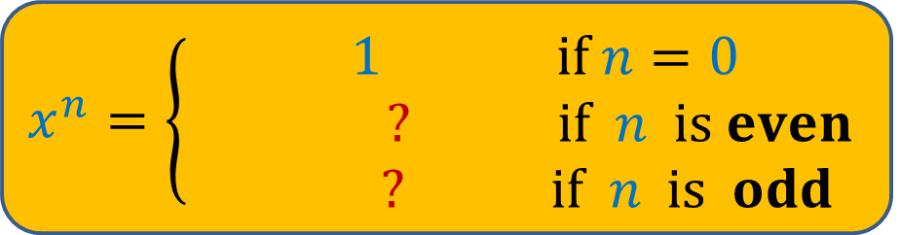
Compute $x^{n}mod m$
Problem: Given three integers $x$, $n$, and $m$, compute $x^{n}mod m$.
Power($x$, $n$, $m$)
If ($n=0$) return 1;
else {
$temp$← Power($x$, $n/2$, $m$);
$temp$← ($temp$× $temp$) $mod m$ ;
if ($n mod 2=1$) $temp$←($temp$× $x$)$mod m$ ;
return $temp$;
}
$$x^{n}=\left\{\begin{aligned} 1 if n=0 \\ ? if n is even \\ ? if n is odd\end{aligned}\right.$$
$$x^{n/2} \text{× }x^{n/2}$$
$$x^{n/2} \text{× }x^{n/2}\text{×} x$$
5 instructions
excluding the
Recursive call

Slide 22

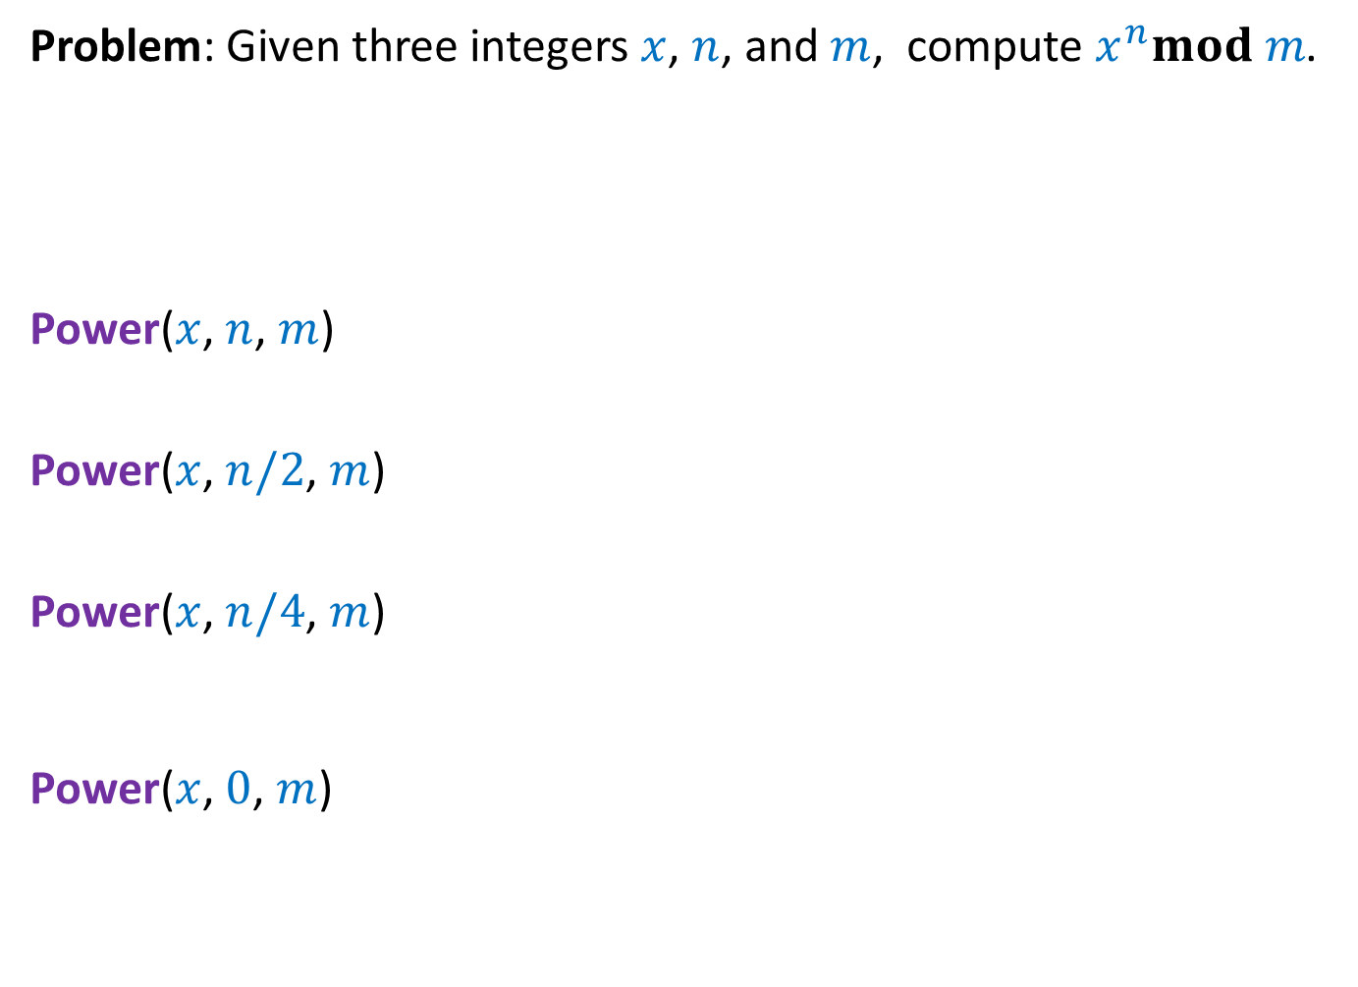
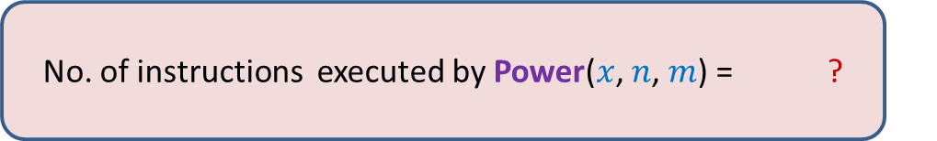
Compute $x^{n}mod m$
Problem: Given three integers $x$, $n$, and $m$, compute $x^{n}mod m$.
Power($x$, $n$, $m$)
Power($x$, $n/2$, $m$)
Power($x$, $n/4$, $m$)
Power($x$, $0$, $m$)
$$x^{n}=\left\{\begin{aligned} 1 if n=0 \\ ? if n is even \\ ? if n is odd\end{aligned}\right.$$
$$x^{n/2} \text{× }x^{n/2}$$
$$x^{n/2} \text{× }x^{n/2}\text{×} x$$
No. of instructions executed by Power($x$, $n$, $m$) = ?
$$5 \log_{2} n$$

Slide 23

Efficient Algorithm for F($n$)mod $m$

Slide 24

Idea 1
Question: Can we express F($n$) as $a^{n}$ for some constant $a$ ?
Unfortunately no.

Slide 25

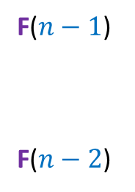
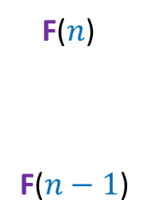
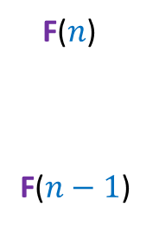
Idea 2
F($n$)
F($n−1$)
1
1 0
F($n−1$)
F($n−2$)
?
Unfolding the RHS of this equation, we get …
$$n−1$$
?
F($n$)
F($n−1$)
1
0
1
1 0

Slide 26
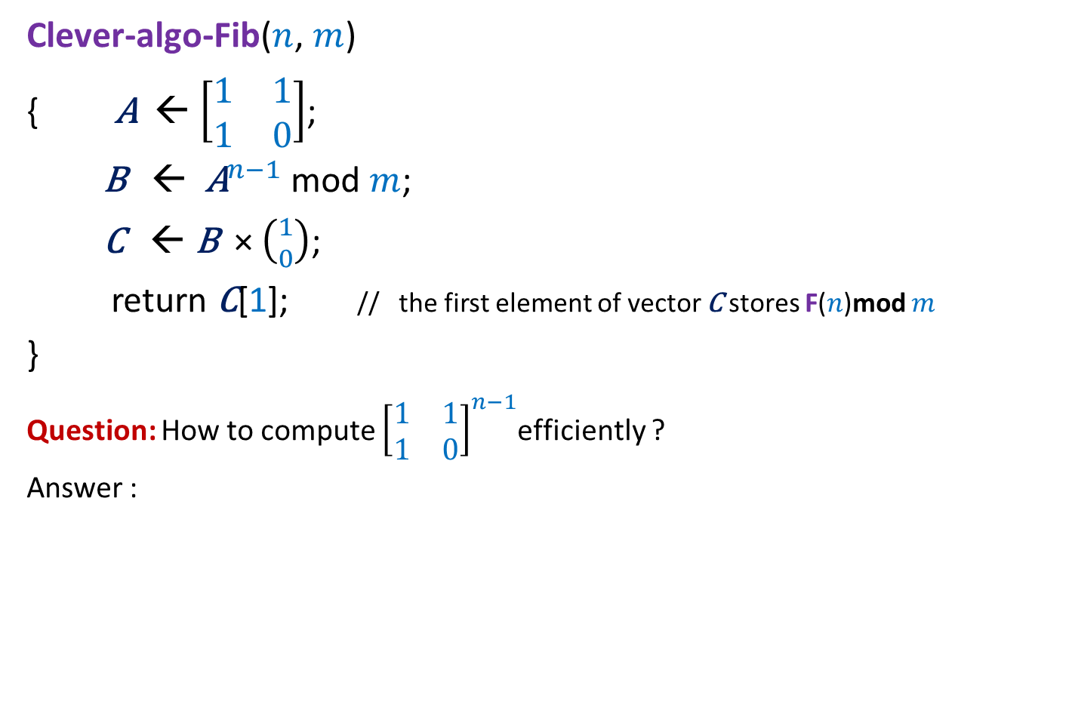


A clever algorithm for F($n$)mod $m$
Clever-algo-Fib($n$, $m$)
{ $\text{A}$← $\left[\begin{matrix}1 & 1 \\ 1 & 0\end{matrix}\right]$;
$\text{B}$ ← ${\text{A}}^{n−1}$ mod $m$;
$\text{C}$ ← $\text{B}$ × $\left({1 \atop 0}\right)$;
return $\text{C}$[1]; // the first element of vector $\text{C}$ stores F($n$)mod $m$
}
Question: How to compute ${\left[\begin{matrix}1 & 1 \\ 1 & 0\end{matrix}\right]}^{n−1}$efficiently ?
Answer :
4 instructions
6 instructions
Inspiration from Algorithm for $x^{n}mod m$

Slide 27
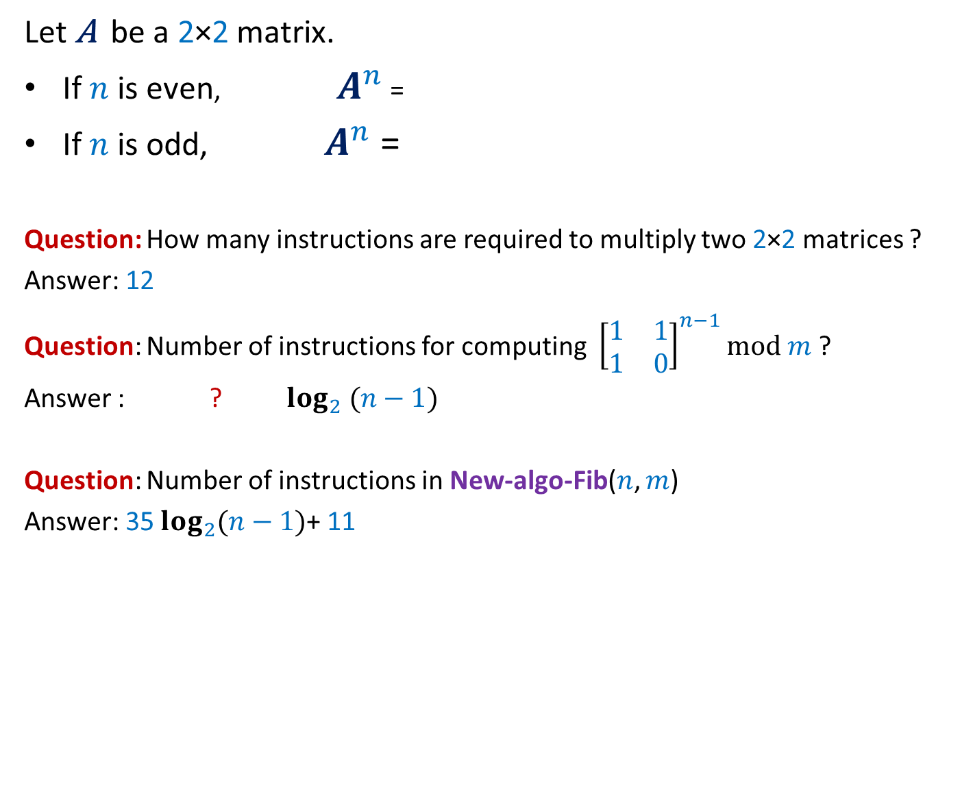
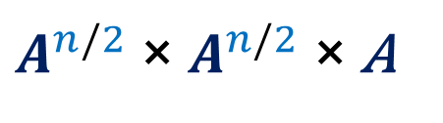
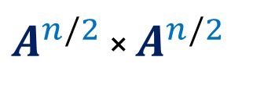
A clever algorithm for F($n$)mod $m$
Let $\text{A}$ be a 2×2 matrix.
If $n$ is even, $A^{n}$ =
If $n$ is odd, $A^{n}$ =
Question: How many instructions are required to multiply two 2×2 matrices ?
Answer: 12
Question: Number of instructions for computing ${\left[\begin{matrix}1 & 1 \\ 1 & 0\end{matrix}\right]}^{n−1}mod m$ ?
Answer : ? $\log_{2} (n−1)$
Question: Number of instructions in New-algo-Fib($n$, $m$)
Answer: 35 $\log_{2}(n−1)$+ 11
$A^{n/2}$ × $A^{n/2}$
$A^{n/2}$ × $A^{n/2}$ × $\text{A}$
35
16 + 16 +3

Slide 28
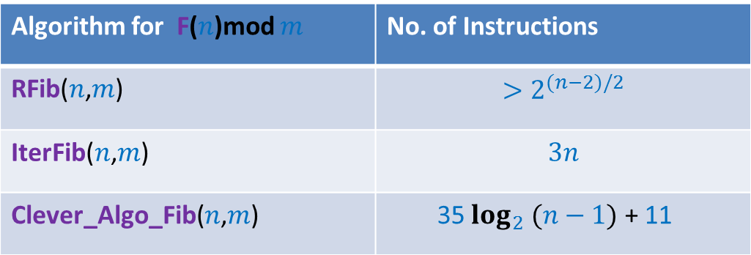
Three algorithms
Algorithm for F($n$)mod $m$ | No. of Instructions
RFib($n$,$m$) | $$>2^{(n−2)/2}$$
IterFib($n$,$m$) | $$3n$$
Clever_Algo_Fib($n$,$m$) | 35 $\log_{2} (n−1)$ + 11
Which algorithm is the best ?
What is the exact base of the exponent in the running time of RFib ?
Are we justified in ignoring the influence of so many other parameters ?
(Variation in the time of instructions/Architecture/Code optimization/…)
How close to reality is the RAM model of computation ?
Find out yourself !
?

